Slide 1

Investor Relations
Profile & Portfolio
IR webpages, mobile applications
and financial information
Argaam Investor Relations
01
Notes:
Source: User-supplied Argaam IR service context and Active - Argaam IR Clients 2026.xlsx (September 2026). Client labels describe service scope in that file, not independently verified live-launch status. No commercial or payment information included.

Slide 2
An extension of your IR team
Argaam supports listed companies in communicating with
shareholders, investors and analysts.
Saudi market expertise
Connected delivery
Ongoing support
Financial information and local market knowledge.
Coordination across design, technology, data and content.
Client coordination, platform updates and maintenance.
02
Notes:
Source: User-supplied Argaam IR service context and Active - Argaam IR Clients 2026.xlsx (September 2026). Client labels describe service scope in that file, not independently verified live-launch status. No commercial or payment information included.

Slide 3
Investor Relations services
IR webpages
IR applications
Standard and Upgraded solutions for a dedicated investor destination.
iOS and Android applications in Arabic and English.
03
Notes:
Source: User-supplied Argaam IR service context and Active - Argaam IR Clients 2026.xlsx (September 2026). Client labels describe service scope in that file, not independently verified live-launch status. No commercial or payment information included.

Slide 4
IR webpage solutions
Standard IR
Upgraded IR
Structured template
Share and financial information
Reports and disclosures
Corporate website integration
Customized design aligned with your brand
Interactive financial information
Company and investor resources
Coordinated delivery and support
Features depend on the agreed package and scope. Share information is subject to applicable Saudi Exchange licensing.
04
Notes:
Source: User-supplied Argaam IR service context and Active - Argaam IR Clients 2026.xlsx (September 2026). Client labels describe service scope in that file, not independently verified live-launch status. No commercial or payment information included.

Slide 5
IR mobile applications
Accessible information
Bilingual experience
Investor updates
Investor information in a dedicated iOS and Android application.
Arabic and English interfaces using the standard application template.
Push notifications to support ongoing investor communications.
05
Notes:
Source: User-supplied Argaam IR service context and Active - Argaam IR Clients 2026.xlsx (September 2026). Client labels describe service scope in that file, not independently verified live-launch status. No commercial or payment information included.

Slide 6
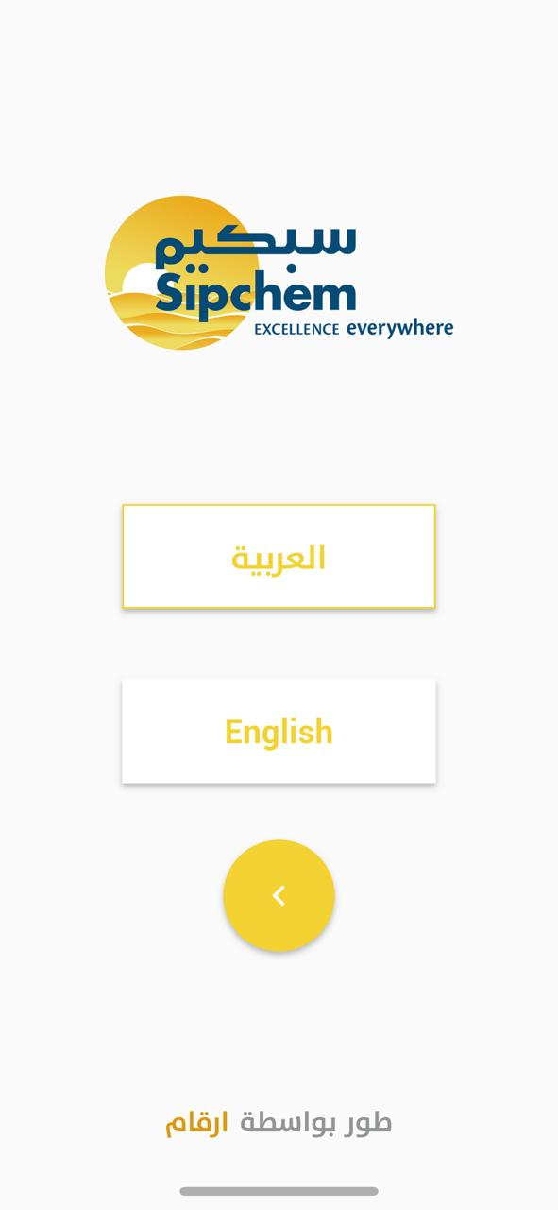
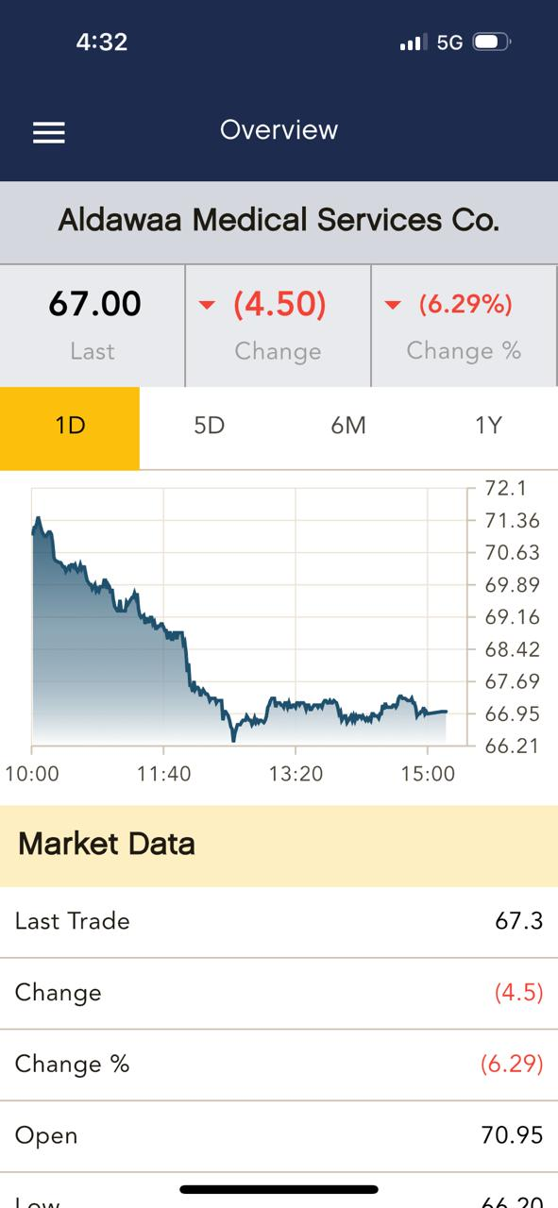
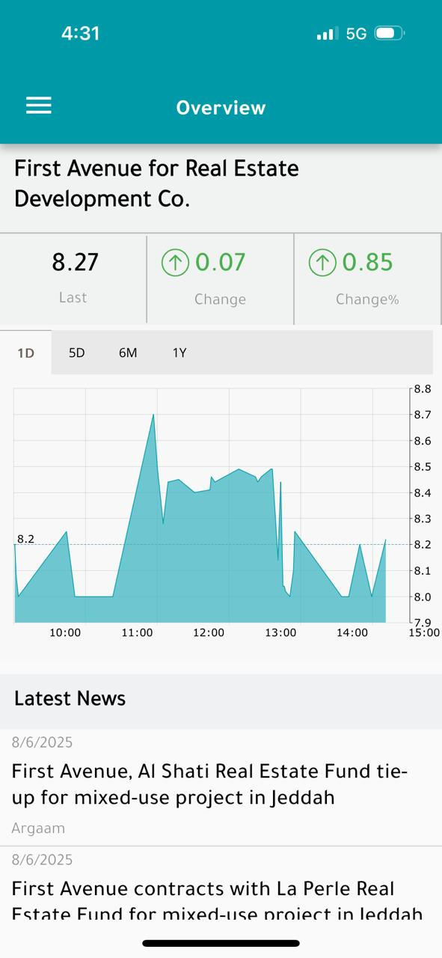
Investor communication on the go
A dedicated iOS and Android app
Connect investors with financial information, company updates and interactive tools through a mobile experience that reflects your brand.
Latest available data, subject to the applicable exchange delay.
Language selection
Aldawaa overview
First Avenue overview
06
Notes:
Source: User-provided Argaam IR App description and uploaded app screenshots. Client service scope from Active - Argaam IR Clients 2026.xlsx (September 2026). Screens are examples and contain historical figures. Market data timing, menu choices and reporting depend on the agreed scope and availability. The app complements official disclosure processes.

Slide 7
IR app features
Latest information
Push notifications
Share prices, financial reports and corporate announcements.
News and event alerts, with user preferences in settings.
English and Arabic
Shareable content
Easy language switching through the app settings.
Supported content sharing through available device tools.
Branding and menu options
Light and dark themes
Corporate identity within the template. Menu choices follow the agreed scope.
Display options to suit the investor’s viewing preference.
07
Notes:
Source: User-provided Argaam IR App description and uploaded app screenshots. Client service scope from Active - Argaam IR Clients 2026.xlsx (September 2026). Screens are examples and contain historical figures. Market data timing, menu choices and reporting depend on the agreed scope and availability. The app complements official disclosure processes.

Slide 8
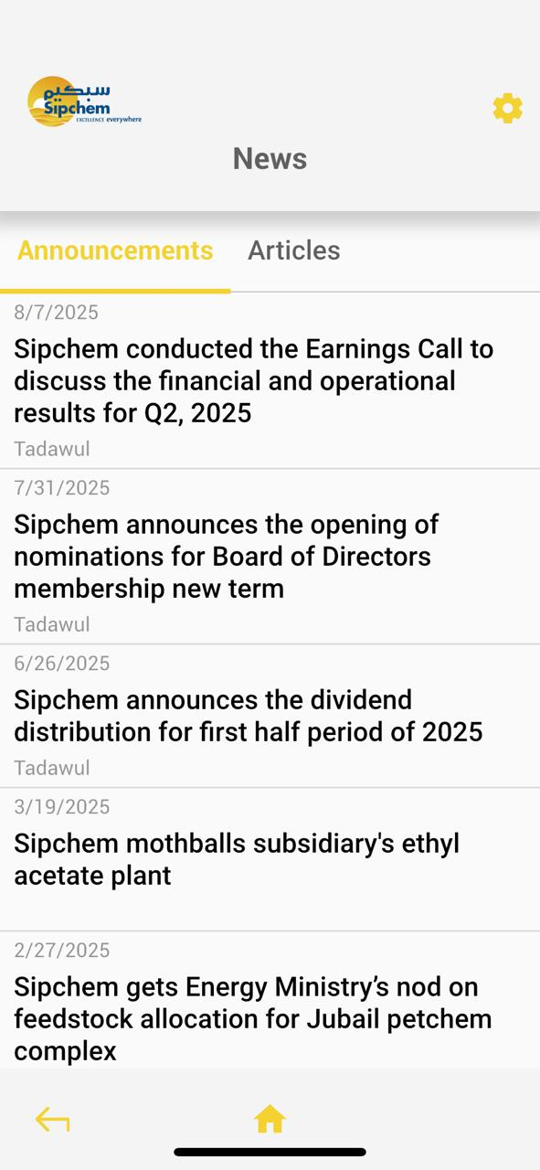
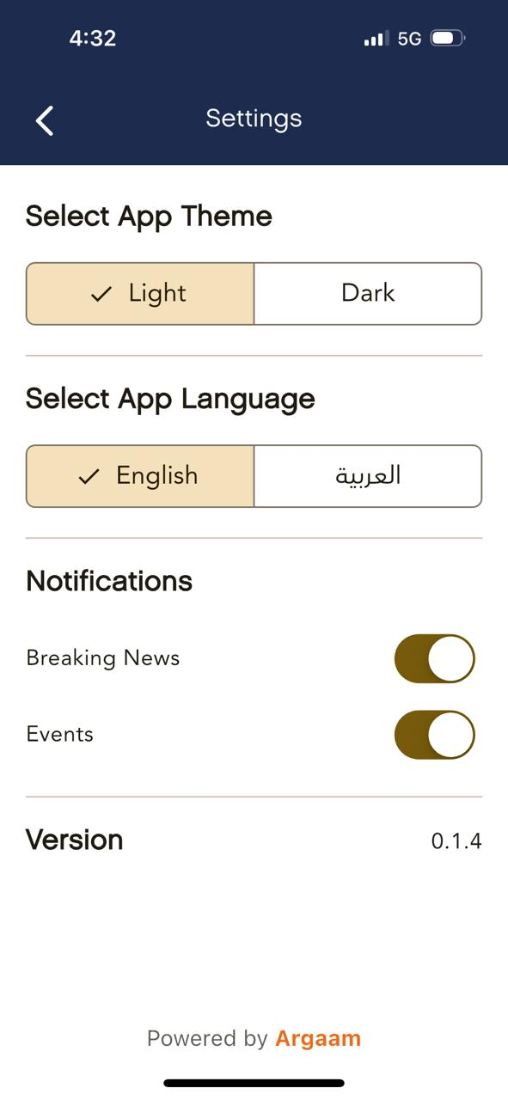
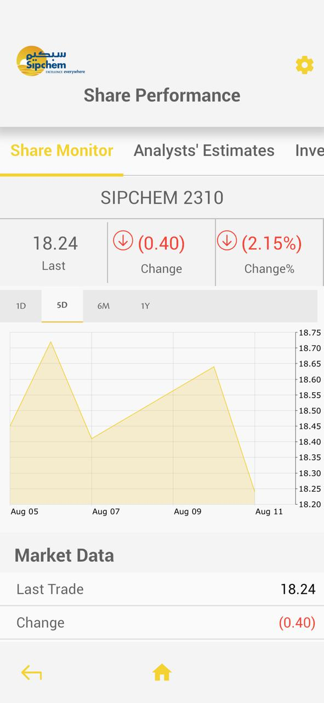
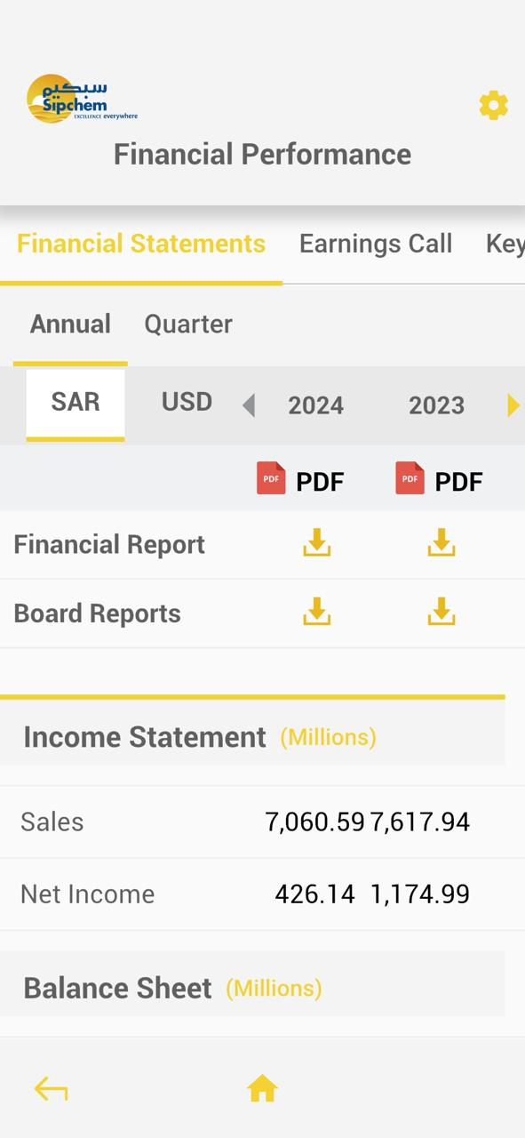
App settings and investor information
Announcements
Language, themes and alerts
Share performance
Financial statements
08
Notes:
Source: User-provided Argaam IR App description and uploaded app screenshots. Client service scope from Active - Argaam IR Clients 2026.xlsx (September 2026). Screens are examples and contain historical figures. Market data timing, menu choices and reporting depend on the agreed scope and availability. The app complements official disclosure processes.

Slide 9
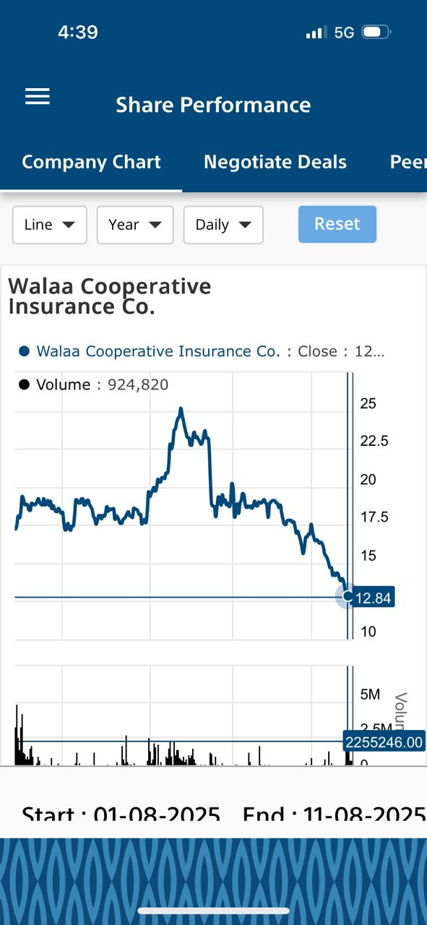
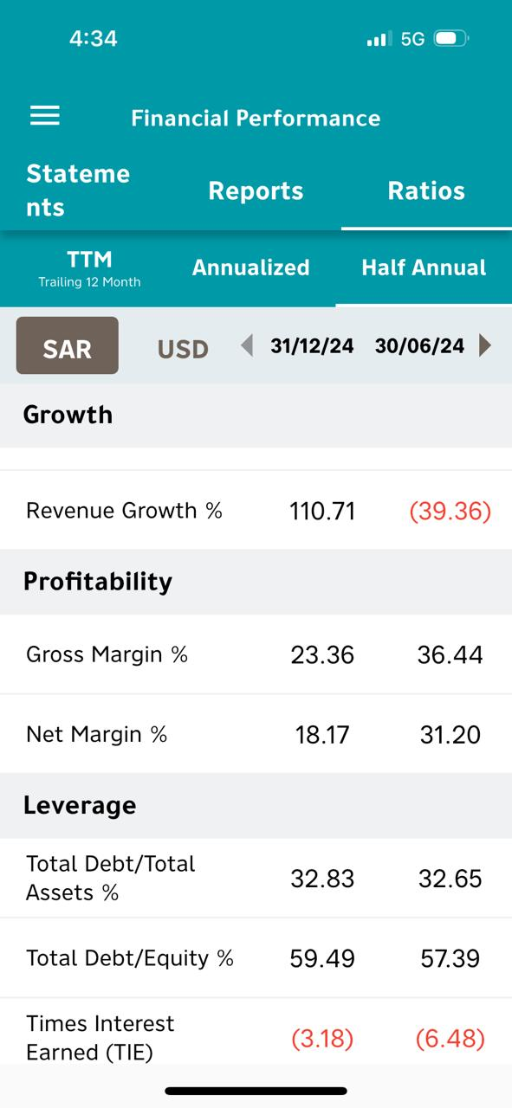
Interactive financial tools
Explore the financial picture
Share charts and financial pages help investors review performance from their phones. Investment calculators and event calendars are available according to the agreed app scope.
Share chart options
Financial ratios
09
Notes:
Source: User-provided Argaam IR App description and uploaded app screenshots. Client service scope from Active - Argaam IR Clients 2026.xlsx (September 2026). Screens are examples and contain historical figures. Market data timing, menu choices and reporting depend on the agreed scope and availability. The app complements official disclosure processes.

Slide 10
Benefits for investors and companies
For investors
For companies
Information available on the go
Convenient access from a mobile device
News and event notification preferences
English and Arabic navigation
Interactive charts and investor resources
A dedicated investor communication channel
A consistent corporate identity
Easier access to published announcements
Less reliance on printed distribution
Available usage statistics and insights
10
Notes:
Source: User-provided Argaam IR App description and uploaded app screenshots. Client service scope from Active - Argaam IR Clients 2026.xlsx (September 2026). Screens are examples and contain historical figures. Market data timing, menu choices and reporting depend on the agreed scope and availability. The app complements official disclosure processes.

Slide 11
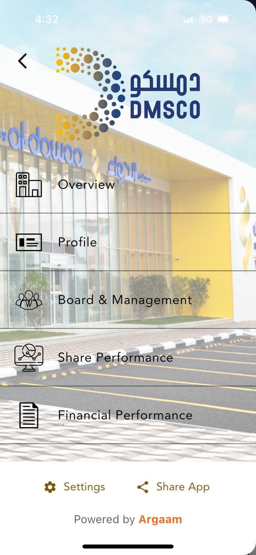
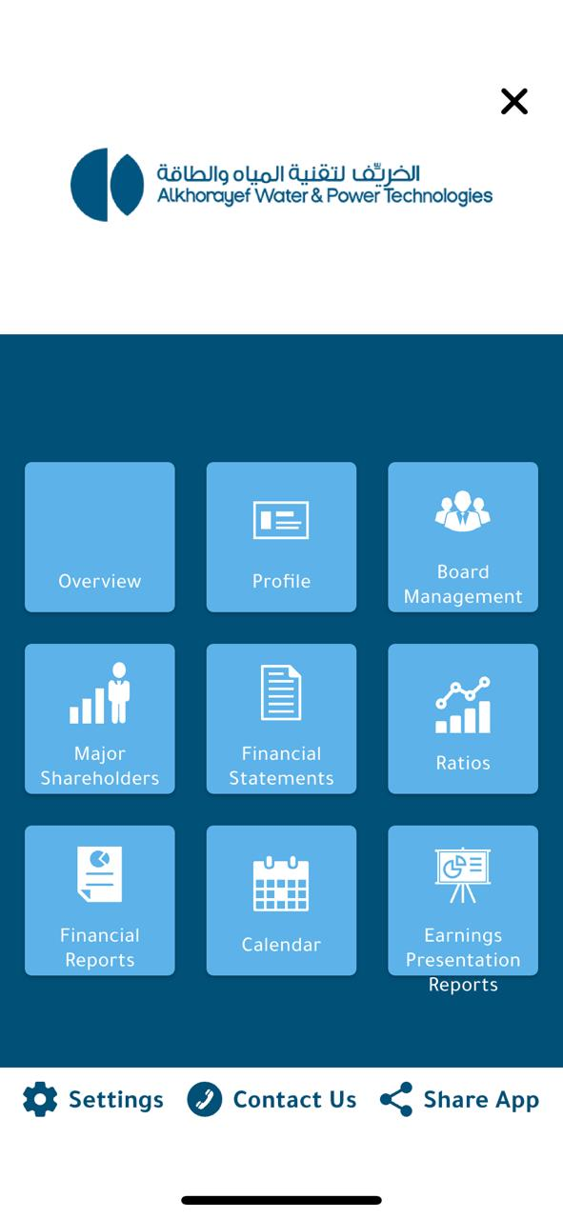
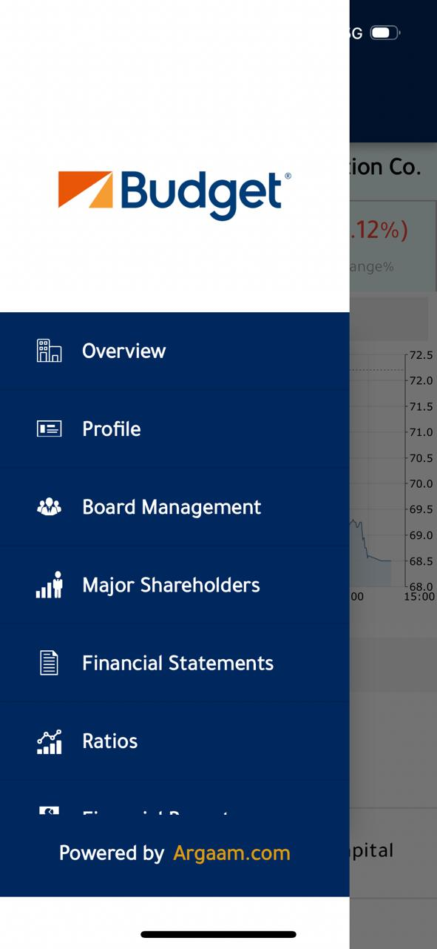
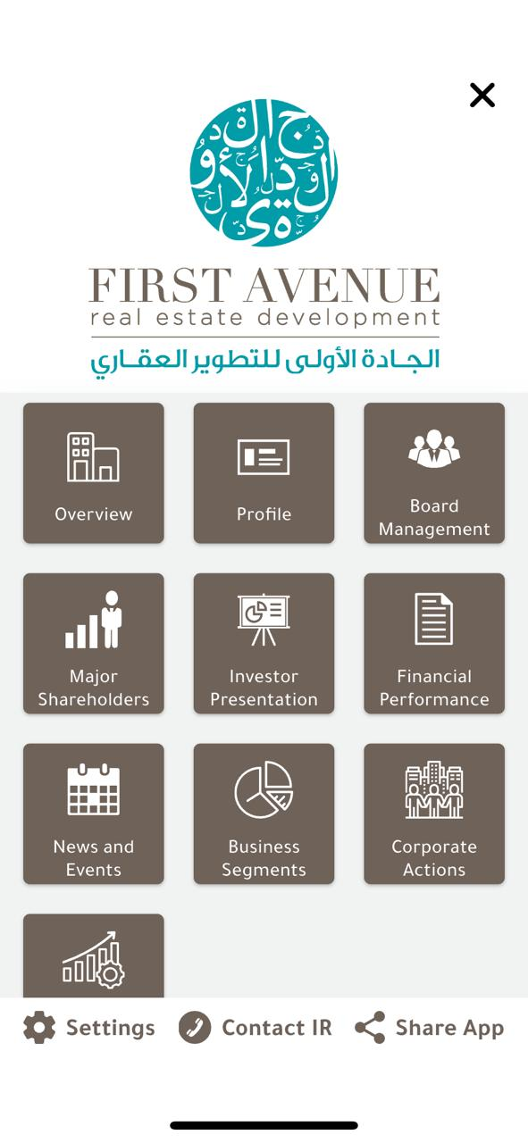
Client IR app designs
Aldawaa
AWPT
Budget Saudi
First Avenue
11
Notes:
Source: User-provided Argaam IR App description and uploaded app screenshots. Client service scope from Active - Argaam IR Clients 2026.xlsx (September 2026). Screens are examples and contain historical figures. Market data timing, menu choices and reporting depend on the agreed scope and availability. The app complements official disclosure processes.

Slide 12
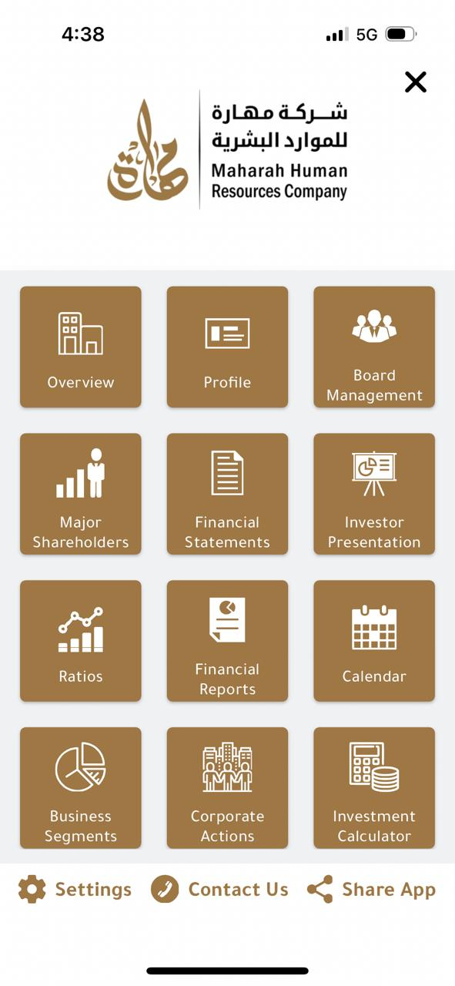
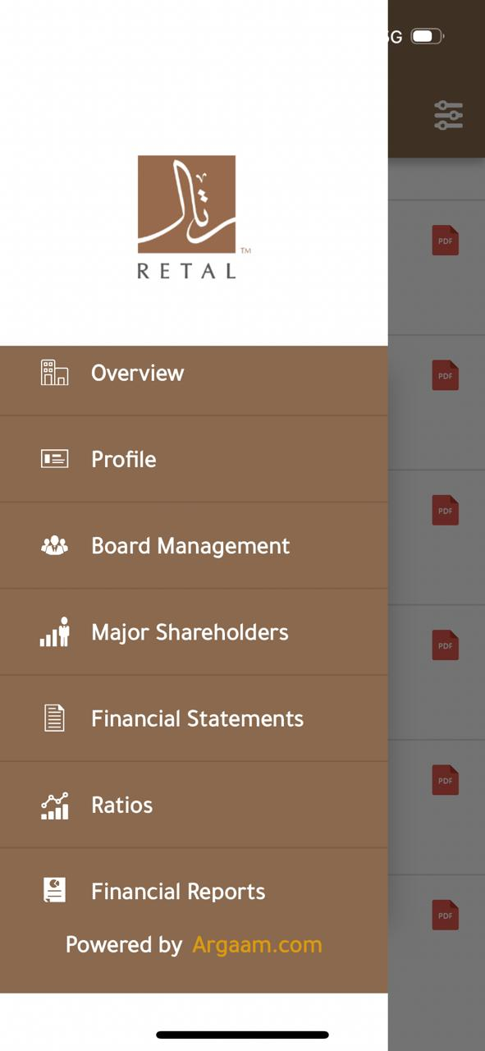
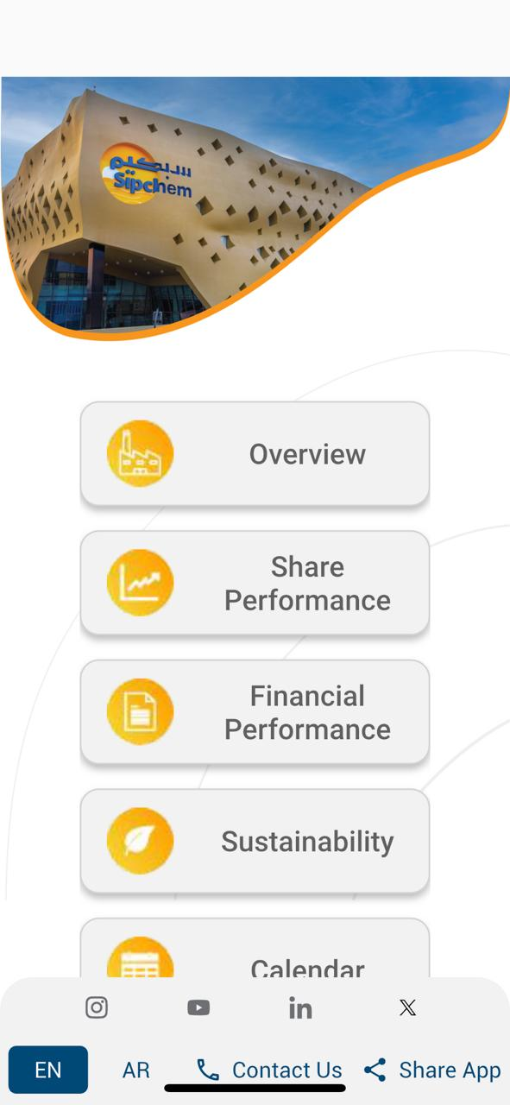
More client IR app designs
Maharah
Retal
Sipchem
12
Notes:
Source: User-provided Argaam IR App description and uploaded app screenshots. Client service scope from Active - Argaam IR Clients 2026.xlsx (September 2026). Screens are examples and contain historical figures. Market data timing, menu choices and reporting depend on the agreed scope and availability. The app complements official disclosure processes.

Slide 13
IR app clients and ongoing support
ALASEEL
BUDGET SAUDI
OASIS
Support beyond launch
ALDAWAA
FIRST AVENUE
RETAL
Corporate website coordination
Usage statistics reports*
Maintenance and technical support
Dedicated IR support team
ALMAJDIAH
GASCO
SAUDI RE
ARDCO
JAZADCO
SIPCHEM
AWPT
MAHARAH
TAIBA
BAAN
MALATH
WALAA
* Downloads, impressions and locations, subject to app-store reporting availability. Client scope: September 2026. Launch status may vary.
13
Notes:
Source: User-provided Argaam IR App description and uploaded app screenshots. Client service scope from Active - Argaam IR Clients 2026.xlsx (September 2026). Screens are examples and contain historical figures. Market data timing, menu choices and reporting depend on the agreed scope and availability. The app complements official disclosure processes.

Slide 14
Financial information & investor resources
Market information
Financial information
Company resources
Share information
Price charts
Investment calculator
Corporate actions
Financial statements
Financial ratios
Reports and presentations
Peer information
Disclosures and news
Board and management
Investor calendar
IR contact details
Modules and content depend on the agreed scope, package and availability.
14
Notes:
Source: User-supplied Argaam IR service context and Active - Argaam IR Clients 2026.xlsx (September 2026). Client labels describe service scope in that file, not independently verified live-launch status. No commercial or payment information included.

Slide 15
Upgraded IR client portfolio
ALDAWAA
BAAN
SAVOLA
IR webpage + IR app
IR webpage + IR app
IR webpage
ALMAJDIAH
EIC
SINAD
IR webpage + IR app
IR webpage
IR webpage
ARDCO
FIRST AVENUE
WALAA
IR webpage + IR app
IR webpage + IR app
IR webpage + IR app
AWPT
GASCO
IR webpage + IR app
IR webpage + IR app
Based on the September 2026 client list. App designation reflects service scope; launch status may vary.
15
Notes:
Source: User-supplied Argaam IR service context and Active - Argaam IR Clients 2026.xlsx (September 2026). Client labels describe service scope in that file, not independently verified live-launch status. No commercial or payment information included.

Slide 16
Standard IR client portfolio
ALASEEL
LADUN
SIPCHEM
IR webpage + IR app
IR webpage
IR webpage + IR app
AME
MAHARAH
SMASCO
IR webpage
IR webpage + IR app
IR webpage
BUDGET SAUDI
MALATH
SUMOU
IR webpage + IR app
IR webpage + IR app
IR webpage
EXTRA
OASIS
TAIBA
IR webpage
IR webpage + IR app
IR webpage + IR app
JABAL OMAR
RETAL
TAMKEEN
IR webpage
IR webpage + IR app
IR webpage
JAZADCO
SAUDI RE
IR webpage + IR app
IR webpage + IR app
Based on the September 2026 client list. App designation reflects service scope; launch status may vary.
16
Notes:
Source: User-supplied Argaam IR service context and Active - Argaam IR Clients 2026.xlsx (September 2026). Client labels describe service scope in that file, not independently verified live-launch status. No commercial or payment information included.

Slide 17
From discovery to ongoing support
01 Discover
02 Design
03 Deliver
04 Support
Define audiences, priorities, content and the appropriate scope.
Coordinate brand requirements, design review and feedback.
Develop, integrate, test and prepare the platform for launch.
Coordinate updates, client requests and maintenance.
17
Notes:
Source: User-supplied Argaam IR service context and Active - Argaam IR Clients 2026.xlsx (September 2026). Client labels describe service scope in that file, not independently verified live-launch status. No commercial or payment information included.

Slide 18
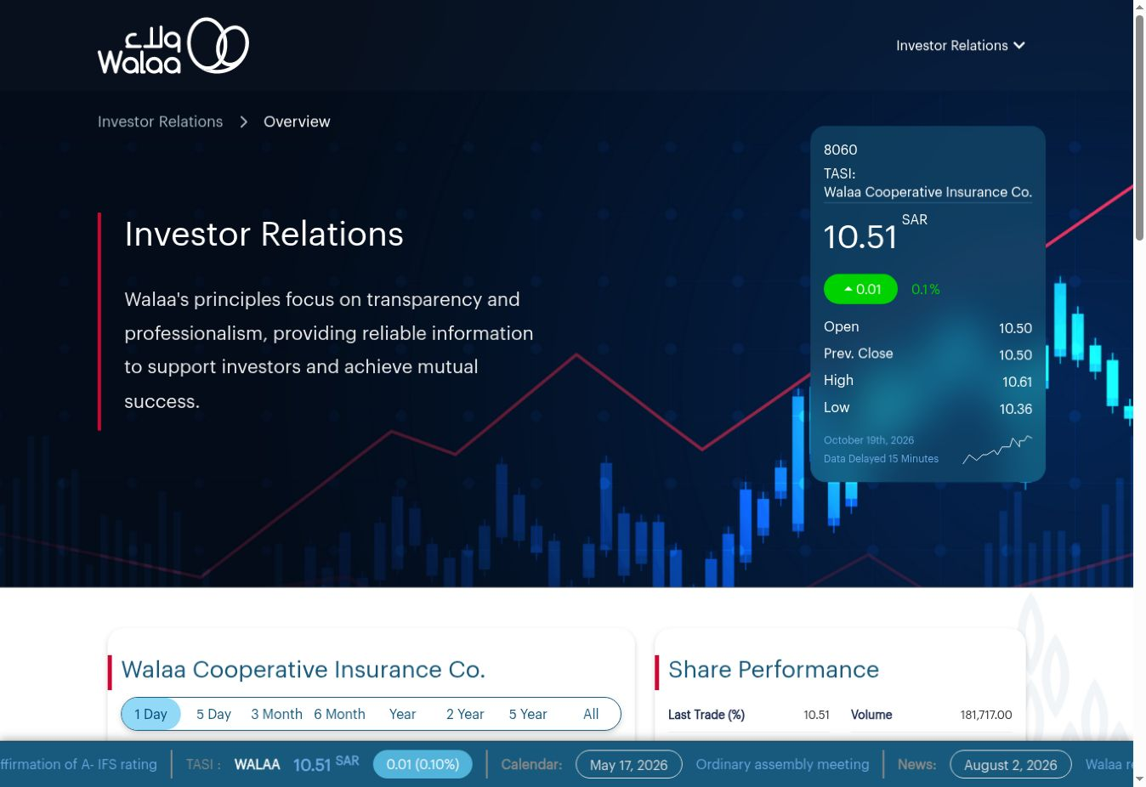
Walaa | Upgraded IR
Client webpage sample
Customized IR webpage aligned with the company’s branding.
18
Notes:
Live client link supplied by user: https://walaa.com/en/overview
Screenshot captured 19 October 2026. Screenshot may show the Argaam-hosted IR module rather than the outer corporate site. Figures are a historical snapshot.

Slide 19
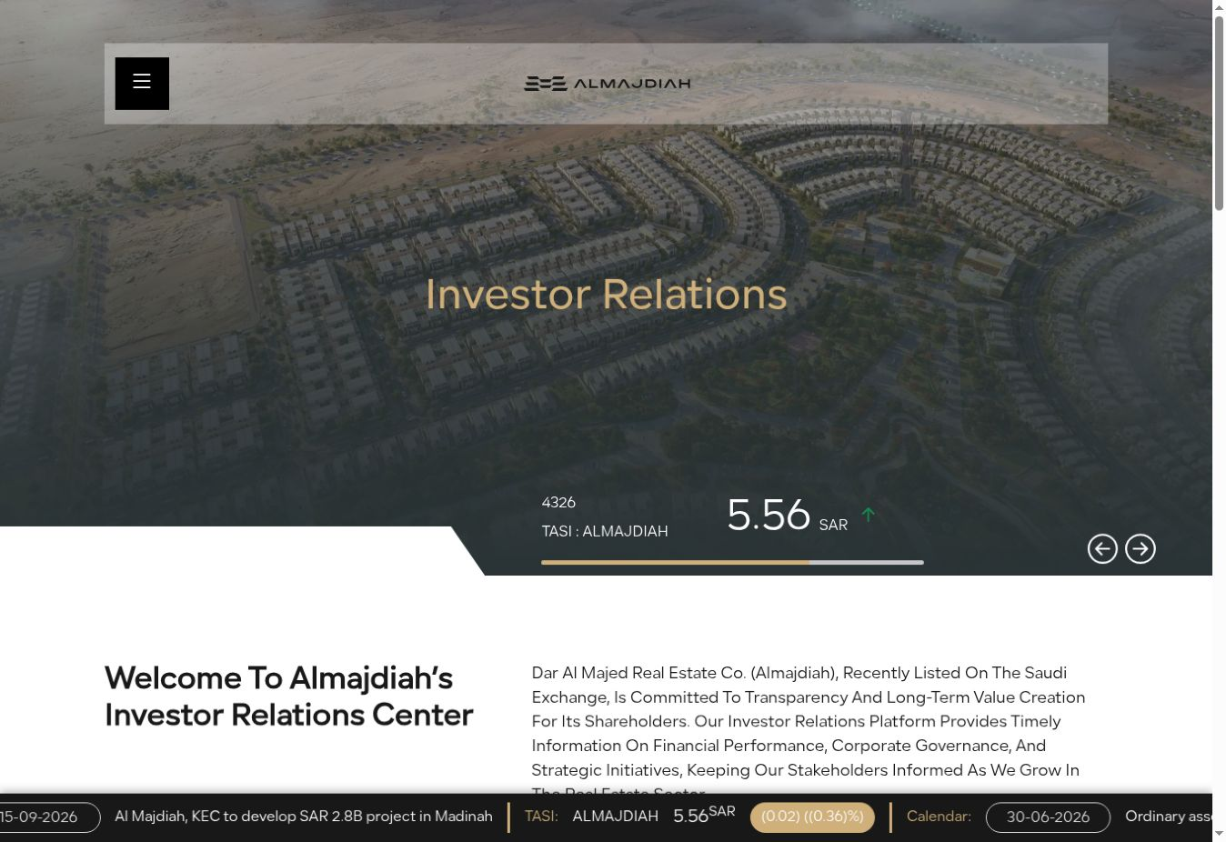
Almajdiah | Upgraded IR
Client webpage sample
Customized IR webpage aligned with the company’s branding.
19
Notes:
Live client link supplied by user: https://almajdiah.argaam-ir.com/en
Screenshot captured 19 October 2026. Screenshot may show the Argaam-hosted IR module rather than the outer corporate site. Figures are a historical snapshot.

Slide 20
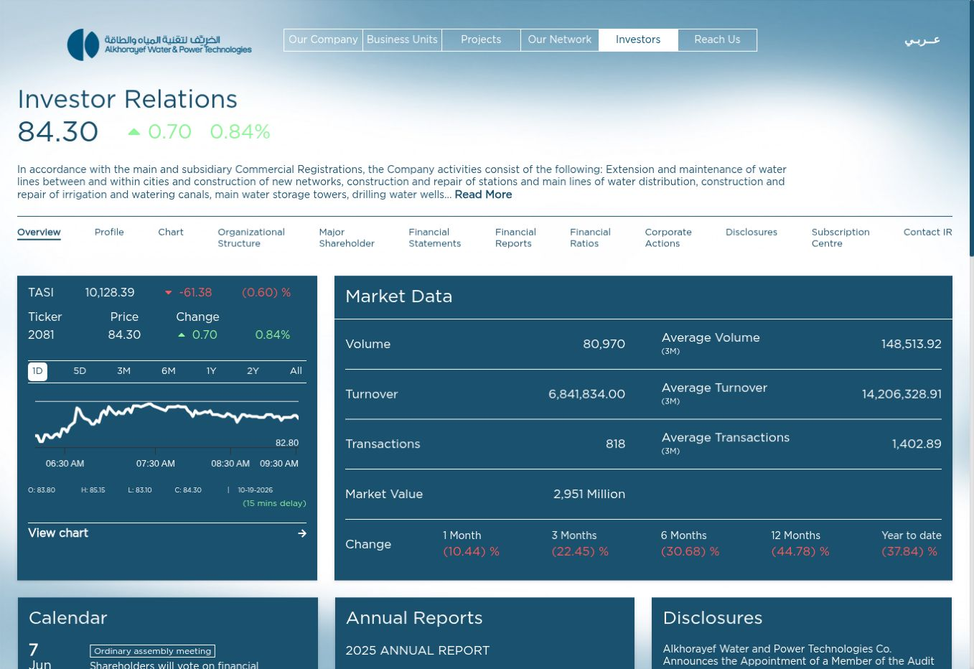
AWPT | Upgraded IR
Client webpage sample
Customized IR webpage aligned with the company’s branding.
20
Notes:
Live client link supplied by user: https://awpt.com.sa/investor-relations/#p_overview
Screenshot captured 19 October 2026. Screenshot may show the Argaam-hosted IR module rather than the outer corporate site. Figures are a historical snapshot.

Slide 21
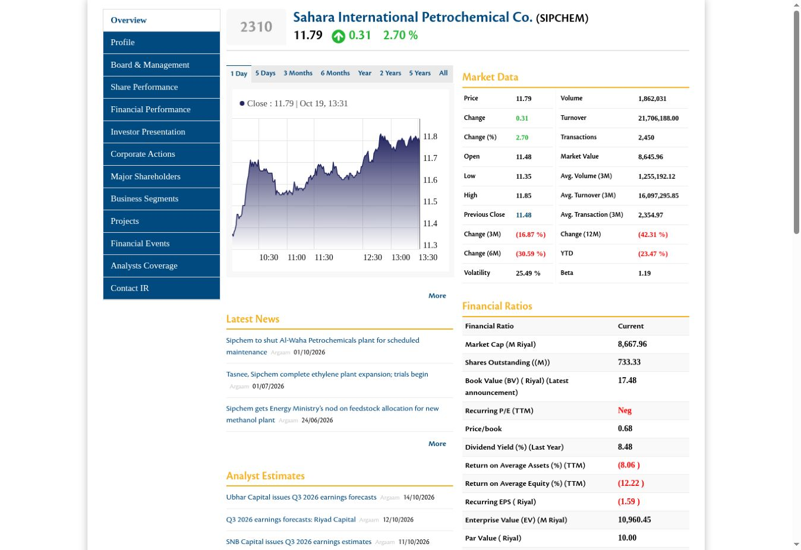
Sipchem | Standard IR
Client webpage sample
Standard IR webpage integrated with the company’s corporate website.
21
Notes:
Live client link supplied by user: https://www.sipchem.com/en/share-tool
Screenshot captured 19 October 2026. Screenshot may show the Argaam-hosted IR module rather than the outer corporate site. Figures are a historical snapshot.

Slide 22
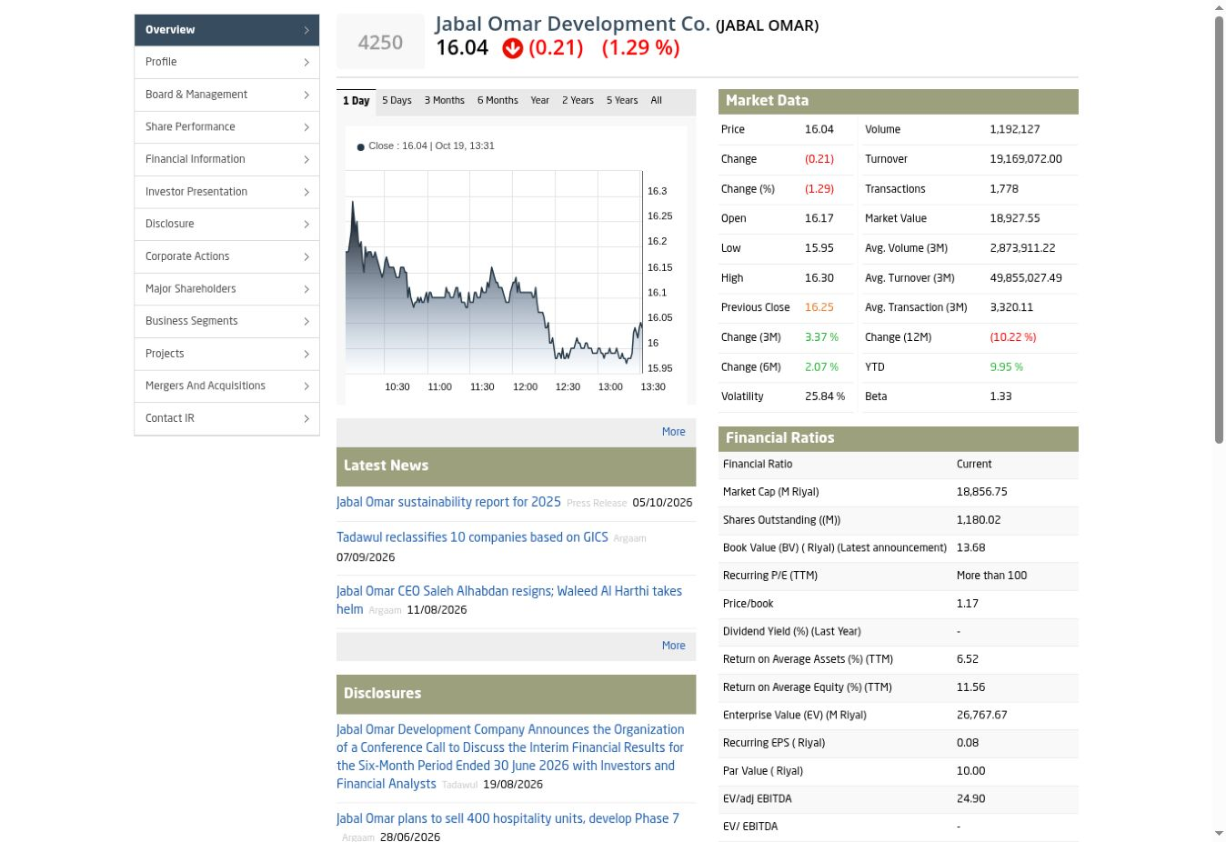
Jabal Omar | Standard IR
Client webpage sample
Standard IR webpage integrated with the company’s corporate website.
22
Notes:
Live client link supplied by user: https://jabalomar.com.sa/en/disclosure/
Screenshot captured 19 October 2026. Screenshot may show the Argaam-hosted IR module rather than the outer corporate site. Figures are a historical snapshot.

Slide 23
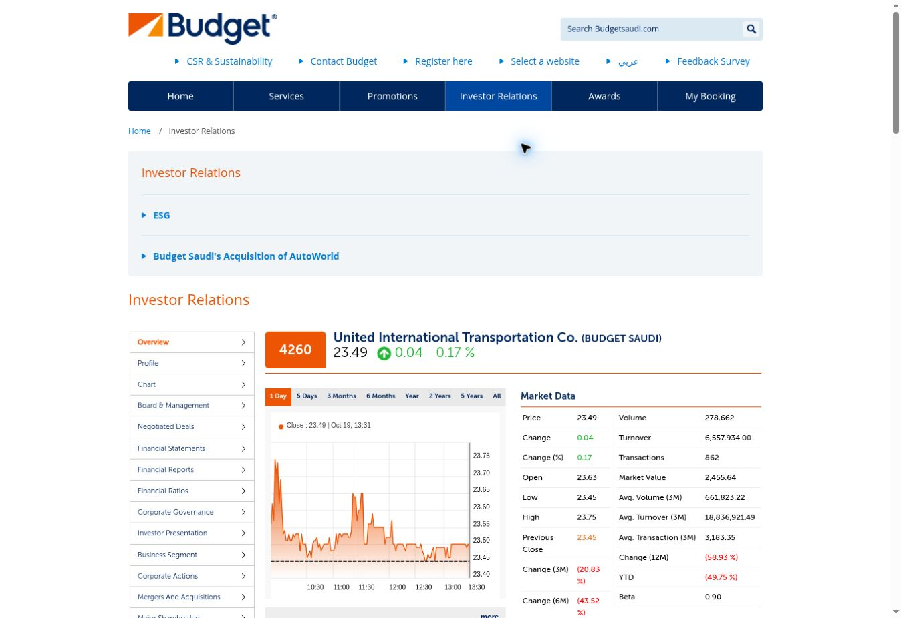
Budget Saudi | Standard IR
Client webpage sample
Standard IR webpage integrated with the company’s corporate website.
23
Notes:
Live client link supplied by user: https://www.budgetsaudi.com/en/Investor-Relations
Screenshot captured 19 October 2026. Screenshot may show the Argaam-hosted IR module rather than the outer corporate site. Figures are a historical snapshot.

Slide 24
Let’s discuss your IR priorities
Loraine Monces
IR Account & Sales Manager
Argaam Investor Relations
Contact
loraine.monces@argaam.com
ir@argaam.com
+966 56 752 1543 | +971 58 867 5175
24
Notes:
Source: User-supplied Argaam IR service context and Active - Argaam IR Clients 2026.xlsx (September 2026). Client labels describe service scope in that file, not independently verified live-launch status. No commercial or payment information included.

